Slide 1

Regional Profitability on superstore dataset
Mudgolwad Ravi
JNTUH COLLEGE OF ENGINEERING SULTANPUR
Aicte no. STU65904a134363a1703954963

Slide 2

Maximizing Regional Profitability
To allocate resources effectively and enhance profits in underperforming regions, I analyzed regional performance. A key challenge was calculating the total profit for each entry and determining any generated profits. To address this issue, I created a visual representation displaying profits across all categories.

Slide 3
Project Description In this project a super store dataset is given for a superstore of United States in which the total profit of all categories and sub-categories on the basis of region is divided. The data also represent different products sales and discount in different region

Slide 4

WHO ARE THE END USERS?
With this project the benefit will be ensured to the clients and majorly to the CA employees
The record team which were going through this problem and some others clients
Through this project the company will easily have a record for their profits of all category .

Slide 5

Technology Used
For this project I have used python programming language and the tools used are mentioned below.
Pandas (library of python used for working with data frame)
Matplotlib (library of python used to visualize represent data )
Seaborn(Extending version for Matplotlib)
I used VS CODE IDE for implementing project.
For visual representation of data Julius AI | Your AI Data Analyst is also been involved in this project.

Slide 6
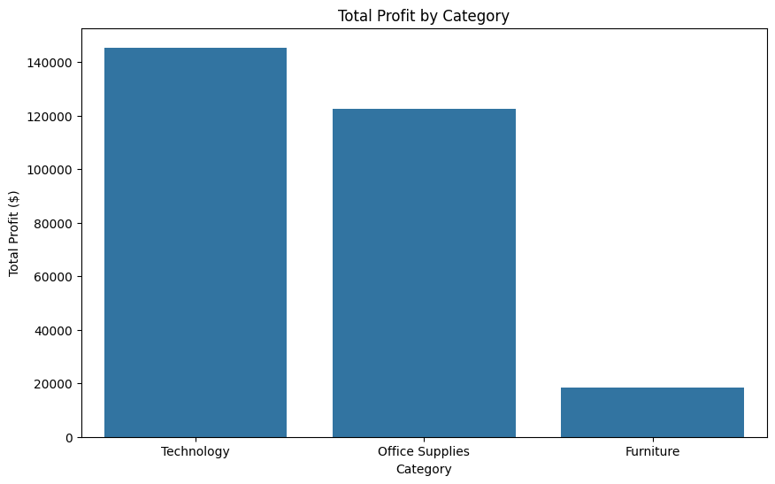
RESULTS
Here, are certainly 3 outputs from the project
I. The first result is a visual representation of Technology category leads in both sales and profits, while Furniture has the lowest profit margin despite decent sales.
Demo Link

Slide 7
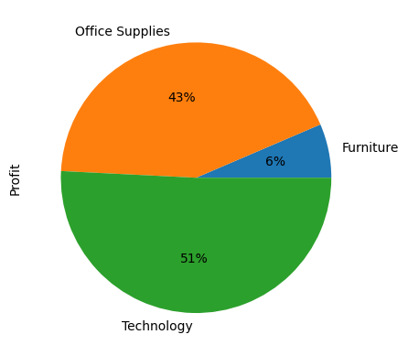
RESULTS
II. The second result is a visual representation of
Category wise profit
This graph represent total profit distributed by every category in each region.
Demo Link

Slide 8
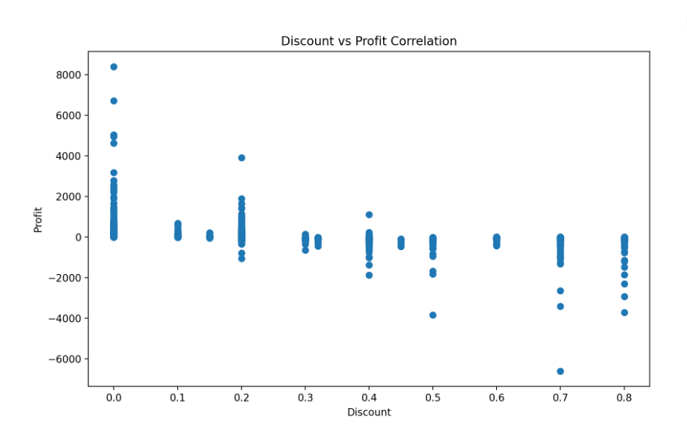
RESULTS
III. The third result is a visual representation of
Discount vs Profit Correlation
This graph represent the correlation between the profits and the discounts of superstore.
There's a negative correlation (-0.219) between discounts and profits, suggesting higher discounts generally lead to lower profits.
Demo Link

Slide 9
Thank you
.

